Slide 2
Machine Learning with Spark MLlib
Manuel Martín Márquez
Antonio Romero Marin
Joeri Hermans
Hadoop Tutorials

Slide 3
Machine Learning (ML)
ML is a branch of artificial intelligence:
Uses computing based systems to make sense out of data
Extracting patterns, fitting data to functions, classifying data, etc
ML systems can learn and improve
With historical data, time and experience
Bridges theoretical computer science and real noise data.

Slide 4

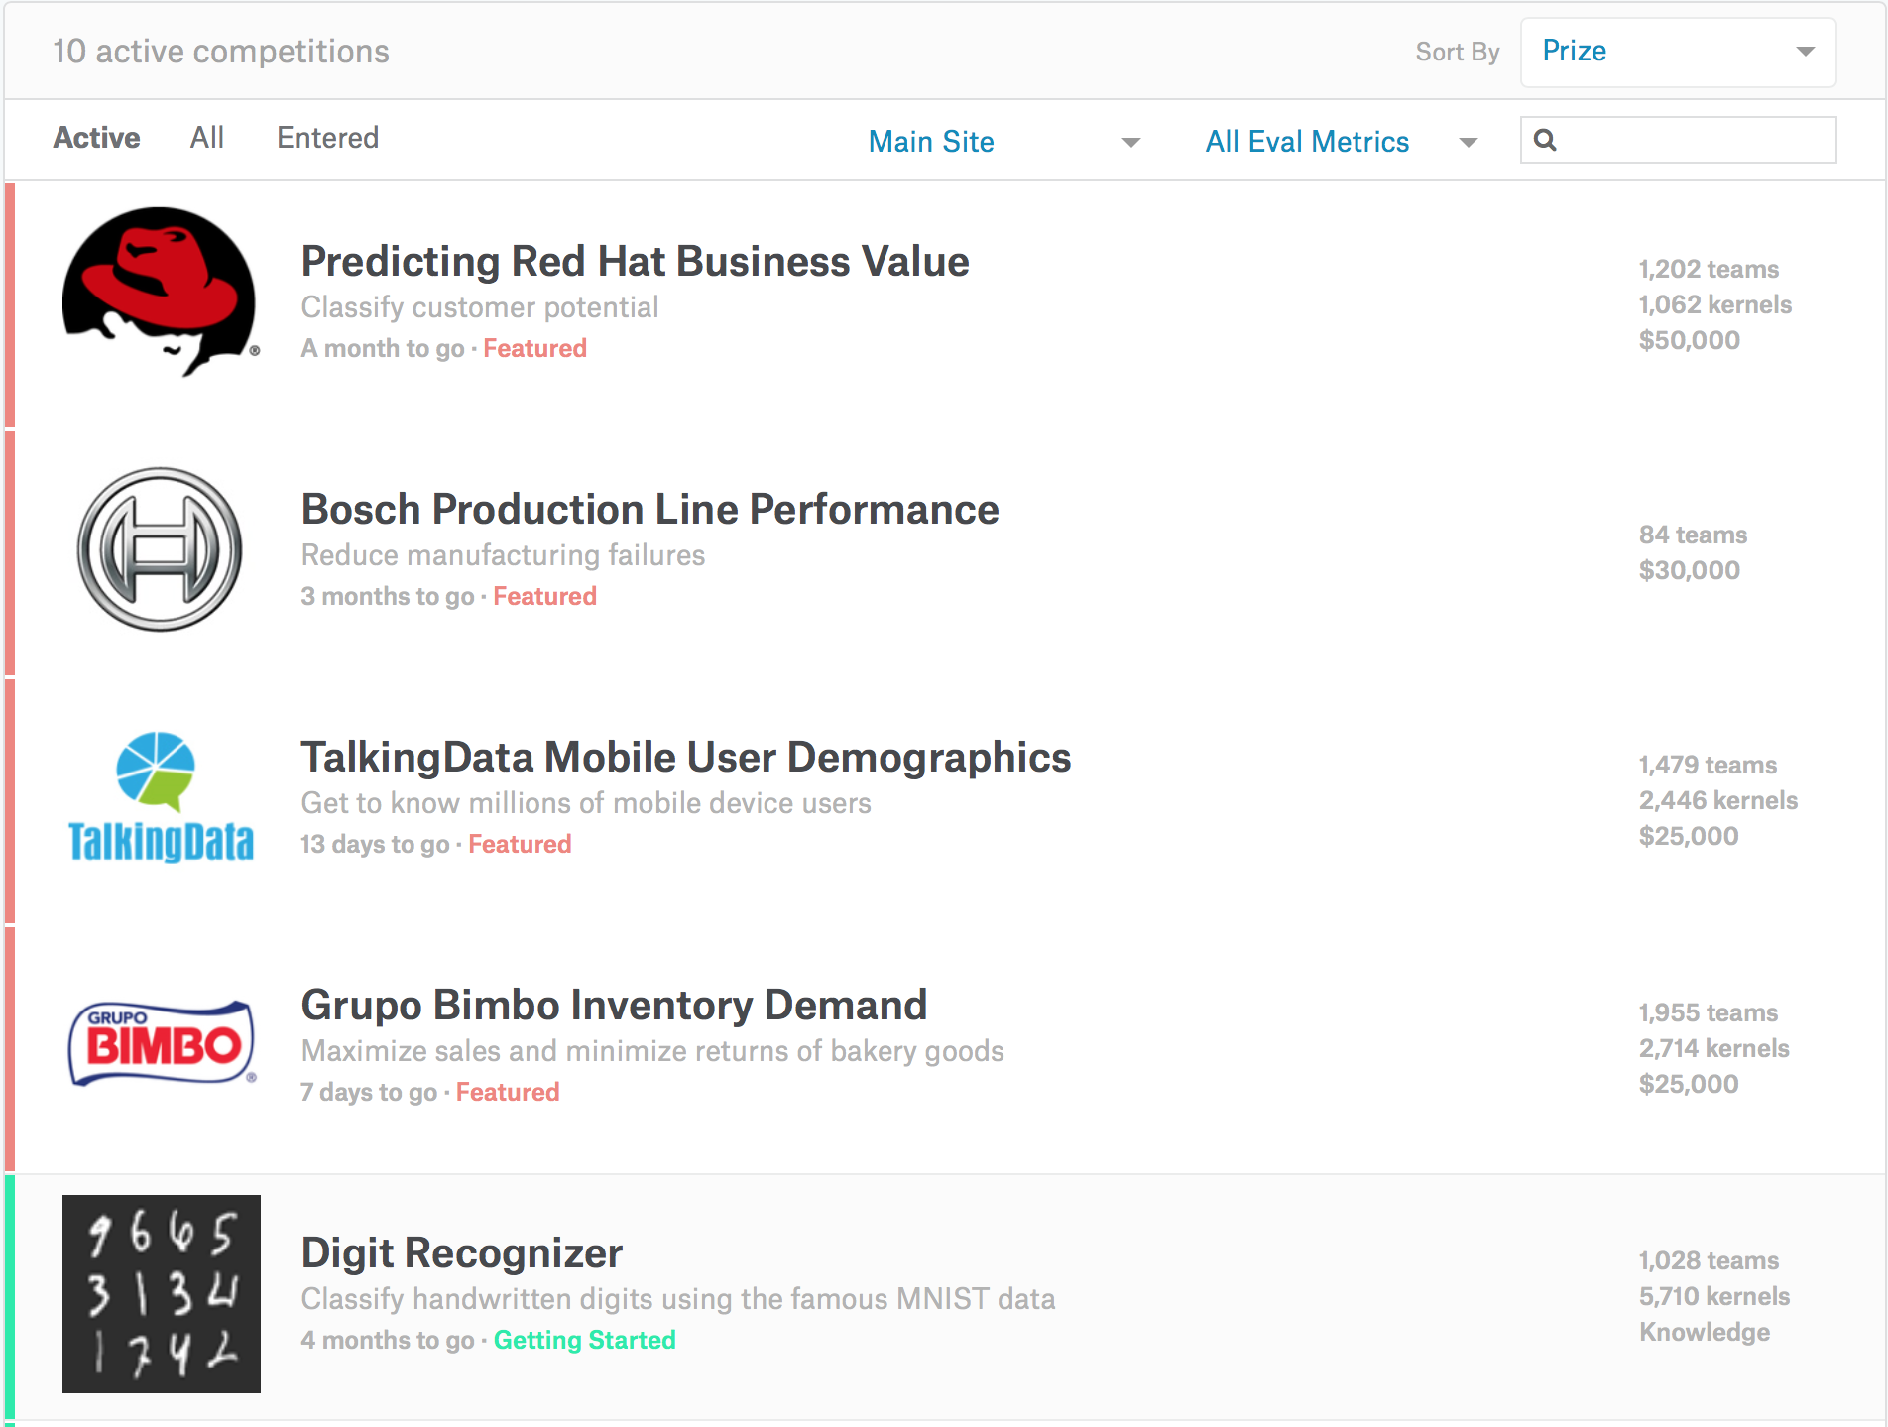

ML in real-life

Slide 5
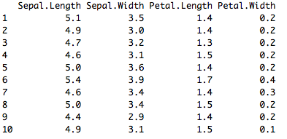
Supervised and Unsupervised Learning
Unsupervised Learning
There are not predefined and known set of outcomes
Look for hidden patterns and relations in the data
A typical example: Clustering
Notes:
ML methods fall into two learning types
Unsupervised
Suppose you want to segment your customers into general categories of people with
similar buying patterns.

Slide 6
Supervised and Unsupervised Learning
Supervised Learning
For every example in the data there is always a predefined outcome
Models the relations between a set of descriptive features and a target (Fits data to a function)
2 groups of problems:
Classification
Regression
Notes:
More formally fits data to a function or a function approximation

Slide 7
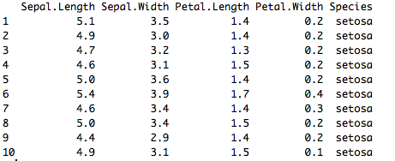
Supervised Learning
Classification
Predicts which class a given sample of data (sample of descriptive features) is part of (discrete value).
Regression
Predicts continuous values.
Notes:
More formally fits data to a function or a function approximation

Slide 8
Machine Learning as a Process
- Define measurable and quantifiable goals
- Use this stage to learn about the problem
Define Objectives
Data Preparation
Model Building
Model Deployment
Model Evaluation
- Normalization
- Transformation
- Missing Values
- Outliers
Study models accuracy
- Work better than the naïve
approach or previous system
Do the results make sense in the context of the problem
- Data Splitting
Features Engineering
Estimating Performance
Evaluation and Model Selection
Notes:
More formally fits data to a function or a function
Adding Roles

Slide 9
ML as a Process: Data Preparation
Needed for several reasons
Some Models have strict data requirements
Scale of the data, data point intervals, etc
Some characteristics of the data may impact dramatically on the model performance
Time on data preparation should not be underestimated
Raw Data
Data Transformation
Data Ready
Scaling
Centering
Skewness
Outliers
Missing Values
Errors
Missing Values
Dimensionality
Types Problems
Error Values
Different Scales
Many others
Modeling phase
Notes:
Add Examples

Slide 10
ML as a Process: Feature engineering
Determine the predictors (features) to be used is one of the most critical questions
Some times we need to add predictors
Reduce Number:
Fewer predictors more interpretable model and less costly
Most of the models are affected by high dimensionality, specially for non-informative predictors
Binning predictors
Wrappers
Multiple models adding and removing parameter
Filters
Evaluate the relevance of the predictor
Based normally on correlations
Algorithms that use models as input and performance as output
Genetics Algorithms
Notes:
Random Forest (tree based) MARS and LASSO internally perform predictor selection
Add Examples

Slide 11
ML as a Process: Model Building
Data Splitting
Allocate data to different tasks
model training
performance evaluation
Define Training, Validation and Test sets
Feature Selection (Review the decision made previously)
Estimating Performance
Visualization of results – discovery interesting areas of the problem space
Statistics and performance measures
Evaluation and Model selection
The ‘no free lunch’ theorem no a priory assumptions can be made
Avoid use of favorite models if NEEDED
Notes:
there is no one single model that will works better than any other a priory

